Slide 1
Reducing The Risk Presentation
Sexual Health Education
https://youtu.be/QGQ_5nD8Q-Q

Slide 2
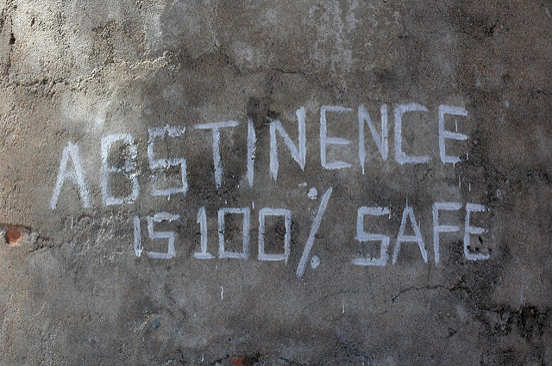
The most reliable way to avoid sexually transmitted infection and pregnancy is to not have sex
(i.e., anal, vaginal or oral).
Abstinence

Slide 3

ABSTINENCE
Abstinence is an equal opportunity behavior.
Anyone can make a conscious choice to not have sex.
Abstinence is a thoughtful choice reflecting personal values.
Abstinence is an expression of personal power and self confidence.
Making decisions that are complex and challenging can make a person stronger.

Slide 5

2015 Youth Risk Behavior Surveillance System
Percentage of High School Students Who Ever Had Sexual Intercourse, by Sex,* Grade,* and Race/Ethnicity,* 2015
According to the 2015 Youth Risk Behavior Study, nationwide approximately _____% of 9th-12th graders have NOT had sex.

Slide 6
Research on Sexual Activity
Research shows that the perception of students thinking that everyone’s doing it is higher than the actual number
Studies report that students who are sexually active, may also be more connected to other risk behaviors (alcohol and drug use) have trouble paying attention, concentrating and learning. In addition, the added stress of anxiety of a potential pregnancy, or having an STI may also make it difficult to concentrate or care in the classroom; and may also cause some students to withdraw, or drop out.

Slide 7

ARE YOU READY FOR SEX? ask yourself……
Am I pressuring my partner?
Who am I doing this for?
Does it go along with my values of waiting until marriage?
Do I only feel the desire to have sex when I am drunk or high?
Am I having sex to keep my partner or to make him or her happy?
What could I gain or lose from having sex?
If the relationship breaks up, will I be glad I had sex with this person?
Do my partner and I share the same feelings and attitudes about the meaning of sex and relationships?
Am I ready to deal with a possible pregnancy or STI?
Am I being pressured to do it?

Slide 8

RELATIONSHIP STEPS
1. Meet-Talk-Exchange #’s: “Interest”
2. Talk-Share-Friendship: “Trust”
3. Date-Talk- “Trust/Respect”
4. Date 1:1-exclusive: “Commitment”
5. Feelings- “Trust/Respect”
6. Express Sexuality- “Hugs & Kisses”
7. “Sexual Intercourse”

Slide 9

99 % of relationships fail when they do not follow those steps.
99%

Slide 10


99% of relationships succeed when they follow the steps.

Slide 11



SEXUALITY CIRCLE
Your sexuality involves all of you!
Heart
Spirit
Mind
Body

Slide 12
*C.P.R’s of
Successful Relationship
Communication that is strong and honest so there is no doubt about what you mean.
Planning for your future to make it healthy and happy.
Relationship Building: Respecting your partner and reassuring that you care about them.
https://play.kahoot.it/#/k/e0afd318-5a32-4b19-b358-0c0da22dc0e1

Slide 14

SEX HAS CONSEQUENCES
Nearly 4 in 10 women become pregnant at least once before age 20- almost one million each year.
Nearly 2/3 of teens who have had sex wish they waited.
80% of teens say they feel pressure to have sex.
Teens say parents influence their decision-making more than any other source.
Nearly all teen pregnancies are unintended.
The U.S. has the highest teen pregnancy rate of all industrialized nations.

Slide 15

Approximate Worldwide Sexual Behaviors:
340,000,000 - cases of curable STI’s
occur every year.
500,000 young people infected w/an
STI every day
550,000 – pregnancies
360,000 – births
140, 000 - abortions
15,000 - cases of HIV infections
7,700 - deaths from AIDS
1,600 - deaths from childbirth complications
500 - deaths from STI’s
Source: United Nations population Fund.

Slide 16

Health benefits of postponing sex
Abstinence is the only 100% effective method of preventing HIV, STI’s, and unplanned pregnancies.
Teenage girls who are sexually active have an increased risk of cervical cancer.
Postponing sex allows you time to make decisions you can live with.

Slide 17
HPV: Human Pappilloma Virus
Genital Warts (Viral)
Most common form of viral STI in U.S. (chlamydia is the most common bacterial STI in the US)
Close to one million cases every year in the U.S. and most of these found in teenagers
One to eight months after infection, warts appear in clusters in contact area
Itching and burning sensation around the warts
You have the virus for life
Linked with cervical cancer
Treatment: warts can be removed but will probably appear again

Slide 18
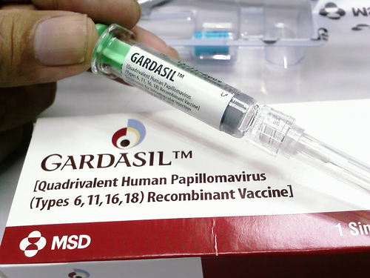
HPV VACCINE
The vaccine Gardasil®, protects against 4 HPV types, which together cause 70% of cervical cancers & 90% of genital warts.
The FDA licensed this vaccine for use in girls/women, ages 9-26. It is also recommended by for boys at age 11-12 years old. The vaccination of boys is also likely to benefit girls by reducing the spread of HPV viruses.
The vaccine is given in a series of three shots over a six month period.

Slide 19
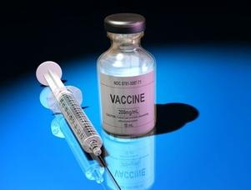
Controversy.
Lawmakers around the country are trying to make the HPV vaccine mandatory. This has caused a big controversy.

Slide 20
Pap Smear
checks for changes in the cells of your cervix. The cervix is the lower part of the uterus (womb) that opens into the vagina (birth canal). The Pap test can tell if you have an infection, abnormal (unhealthy) cervical cells, or cervical cancer.
A Pap test can save your life. It can find the earliest signs of cervical cancer. If caught early, the chance of curing cervical cancer is very high. Pap tests also can find infections and abnormal cervical cells that can turn into cancer cells. Treatment can prevent most cases of cervical cancer from developing.
It is important for all women to have Pap tests, along with pelvic exams, as part of their routine health care. You need a Pap test if you are 21 years or older.

Slide 21
Teen Pregnancy
Kahoot.it
https://play.kahoot.it/#/?quizId=4dd57ff8-a25a-4cd3-99e3-8b3cbd6c6014

Slide 22
Teen Pregnancy Test
Most high school students are having sex.
True or False

Slide 23
#1
FALSE
Not everyone is doing it. Recent data shows that half of high school students report having had sexual intercourse while half report they are virgins.

Slide 24
2. What is the only 100% effective way to prevent a pregnancy?
A. Birth Control Pills
B. Condoms
Spermicide
Abstinence
All of the above

Slide 25
#2
D. Abstinence
The only 100% way to be sure you can prevent pregnancy. No contraceptive method is 100% effective except abstinence.

Slide 26
3. If you don’t use any form of contraception when you have sex, what are your chances of becoming pregnant within one year?
28% C. 76%
85% D. 43%

Slide 27
#3
        B. 85%

Slide 28
4. Do most teens who have sex wish they had waited?
Yes or No

Slide 29
#4
Yes. The poll conducted by National Campaign, 63% of teens who have had sexual intercourse said they wish they had waited.

Slide 30
5. How many girls become pregnant at least once before age 20?
1 in 10
3 in 10
4 in 10
7 in 10

Slide 31
#5
C. 4 in 10
Almost one million a year.

Slide 32
6. What is the percentage of teen mothers that get their high school diploma?
25%
32%
50%
72%

Slide 33
#6
B. 32%
Less than one-third of teens who have children before age 18 ever get their high school diploma.

Slide 34
7. About 50% of the fathers marry the teen mothers of their first children.
True or False

Slide 35
#7
False
About 20% of the fathers marry the teen mothers of their first children. On average, the remaining 80% pay less than $800 annually for child support-that is less than $16 a week.

Slide 36
8. What percent of pregnancies among teens are accidental?
25%
45%
65%
85%

Slide 37
#8
D. 85%
The vast majority- 85% unplanned and 79% to unmarried teens.

Slide 38
9. You can get a STI from having oral sex.
True or False

Slide 39
#9
True
As well as other forms of sexual activity.

Slide 40
10. The daughters of teen mothers are more likely to become teen mothers themselves.
True or False

Slide 41
#10
True
The daughter of teen mothers are 22% more likely to become teen mothers themselves. In addition, the children of teen mothers are at greater risk of abuse and neglect than children born to older parents

Slide 42
Sources cited on the web site: www.teenpregnancy.org

Slide 43

Teen Mom’s
The majority of teens who have babies will have 90% of their life script written for them.
Baby at 16?!? How old are the parents when they leave for college?

Slide 44
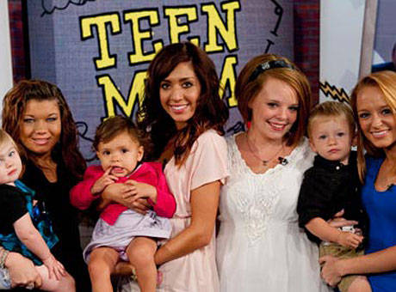
Teen Mom’s will usually…
Drop out of school.
Never be able to earn a decent living.
Be on welfare most of their life.
Be abandoned by the fathers of their babies.
Contribute disproportionately to cases of child abuse and delinquency.

Slide 45



Teen pregnancy is associated with lower levels of the 3 E’s.
LESS Education
LESS Employment
LESS Enjoyment

Slide 46


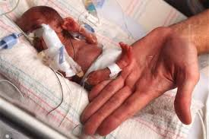
Teen moms experience more health risks during pregnancy than older moms .
Anemia= low red blood cell count, low hemoglobin causes like iron deficiency, ulcers, etc...
Toxemia= pregnancy induced hypertension (high blood pressure)
Premature delivery
Mortality
Cervical trauma
Source: NIDA: Addiction Research Foundation Library Publishers

Slide 47
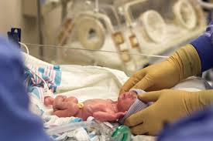
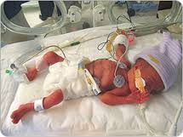
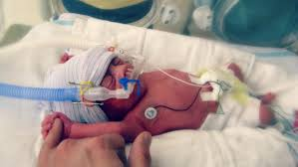
Infants born to teen mothers are at a greater risk of:
Prematurity
Fragile health
Need for intensive care
Cerebral palsy
Epilepsy
Mental impairments
Source: NIDA: Addiction Research Foundation Library Publishers

Slide 48
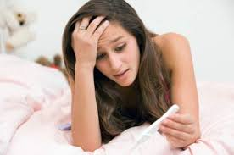
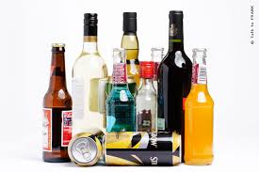
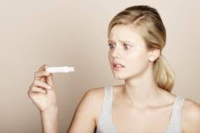
Facts on alcohol and teen pregnancy:
Many girls lose their virginity while drunk.
Unplanned pregnancies ages 14-21, 1/3rd of the girls who had gotten pregnant were drinking when they had sex.
Boys who start drinking at a young age are 40% more likely to have sex at a young age and girls are more susceptible at 80%.
F.A.S.D.

Slide 49
$ Dollars
and
Sense $
Can you afford a baby-even for ONE YEAR?

Slide 50
Cost of Kids?!?
Cost of Raising a Child

Slide 51

DELAY TACTICS
A way of communicating that is an effective alternative to directly saying no, so that you can buy time until we can think about how to communicate what we really want.

Slide 52
Delay Statements Refusal Skills
Make a delay statement.
  stall, make excuse, question, change subject
Take a delay action.
  act distracted, change what your doing
Create Space.
  Use body language, be serious
End the situation quickly.
  leave
Build the relationship
if appropriate, I statements, be honest

Slide 53

Think-Pair-Share
List 5 delay tactics with your neighbor…2 minutes…
  What can you do instead?
  Where could you go?

Slide 54
TEEN DATING VIOLENCE
If you are a female dating right now, there is a 50-50 chance you’ll be abused by a dating partner.
Average age dating violence begins is 15
75% of boys who abuse their girlfriend are from homes where abuse occurred
68% of young women reporting rape were raped in dating relationships
1 out of 3 women murdered in the US are killed by a husband or boyfriend.
1 in 10 teens reported being hit or physically hurt on purpose by a boyfriend or girlfriend at least once in the 12 months prior to the survey
Nearly half of all teens in relationships say they know friends who have been verbally abused.

Slide 55
WARNING SIGNS that a dating partner may eventually become abusive include:
Extreme jealousy, monitors your every move
Blaming others for problems
Never able to admit wrongdoings
Cruelty to animals
Rigid beliefs about sex-roles
Controlling : makes all decisions and keeps you from seeing friends/family
Name calling, put-downs, make you feel bad about yourself
Threats
Violent behavior: slams doors, hits, punching walls,etc.
Tries to make up buy saying they are sorry, they love you, it will NEVER happen again and/or buying you flowers, jewelry

Slide 56

How do I get help??
Realize you are Not alone
Recognize signs & symptoms
See a counselor
Call a hotline: Alexandra House 24 hour crisis Line: (763)780-2330

Slide 57
The Sexual decisions YOU make today…… will affect your
FUTURE!
3,ooo teens will get pregnant today!
Every 10 seconds, a teen will get an STI.
68% of teens stated that they choose to be virgins.
32% of condoms used within the last 16 days broke during use.
75% of women who have chlamydia don’t know they have it while it is destroying their bodies.
The younger a person is who chooses to engage in sexual behavior, the higher their risk of cancer. (Cervical, uterine, etc.)

Slide 58

Abstinence is a healthy CHOICE that you have the right to practice!

Slide 59
S.T.I. Rap
https://youtu.be/JVt_CZ1QI0k

Slide 60

H . I . V .
Human Immunodeficiency Virus
  Transmitted by
    Breast milk
    Blood
    Vaginal fluid
    Semen
    Anal Fluids
Accurate Test=3 months!

Slide 61
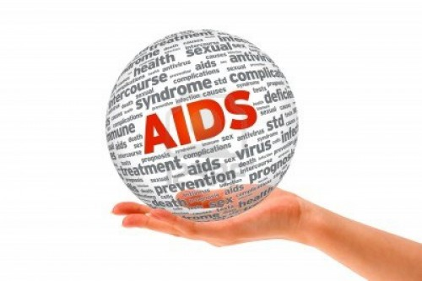
A . I . D . S .
Acquired Immune Deficiency Syndrome
H.I.V Turns into A . I . D . S.
=T-cell count below 200
Don’t die from Aids, but complications of another illness

